Slide 1
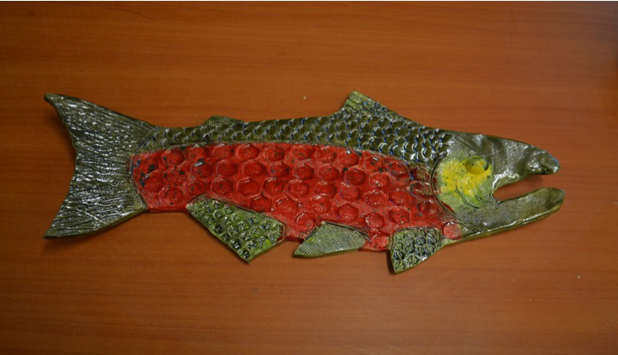
Salmon Platters
Notes:
Here is a photo of today’s project.

Slide 2
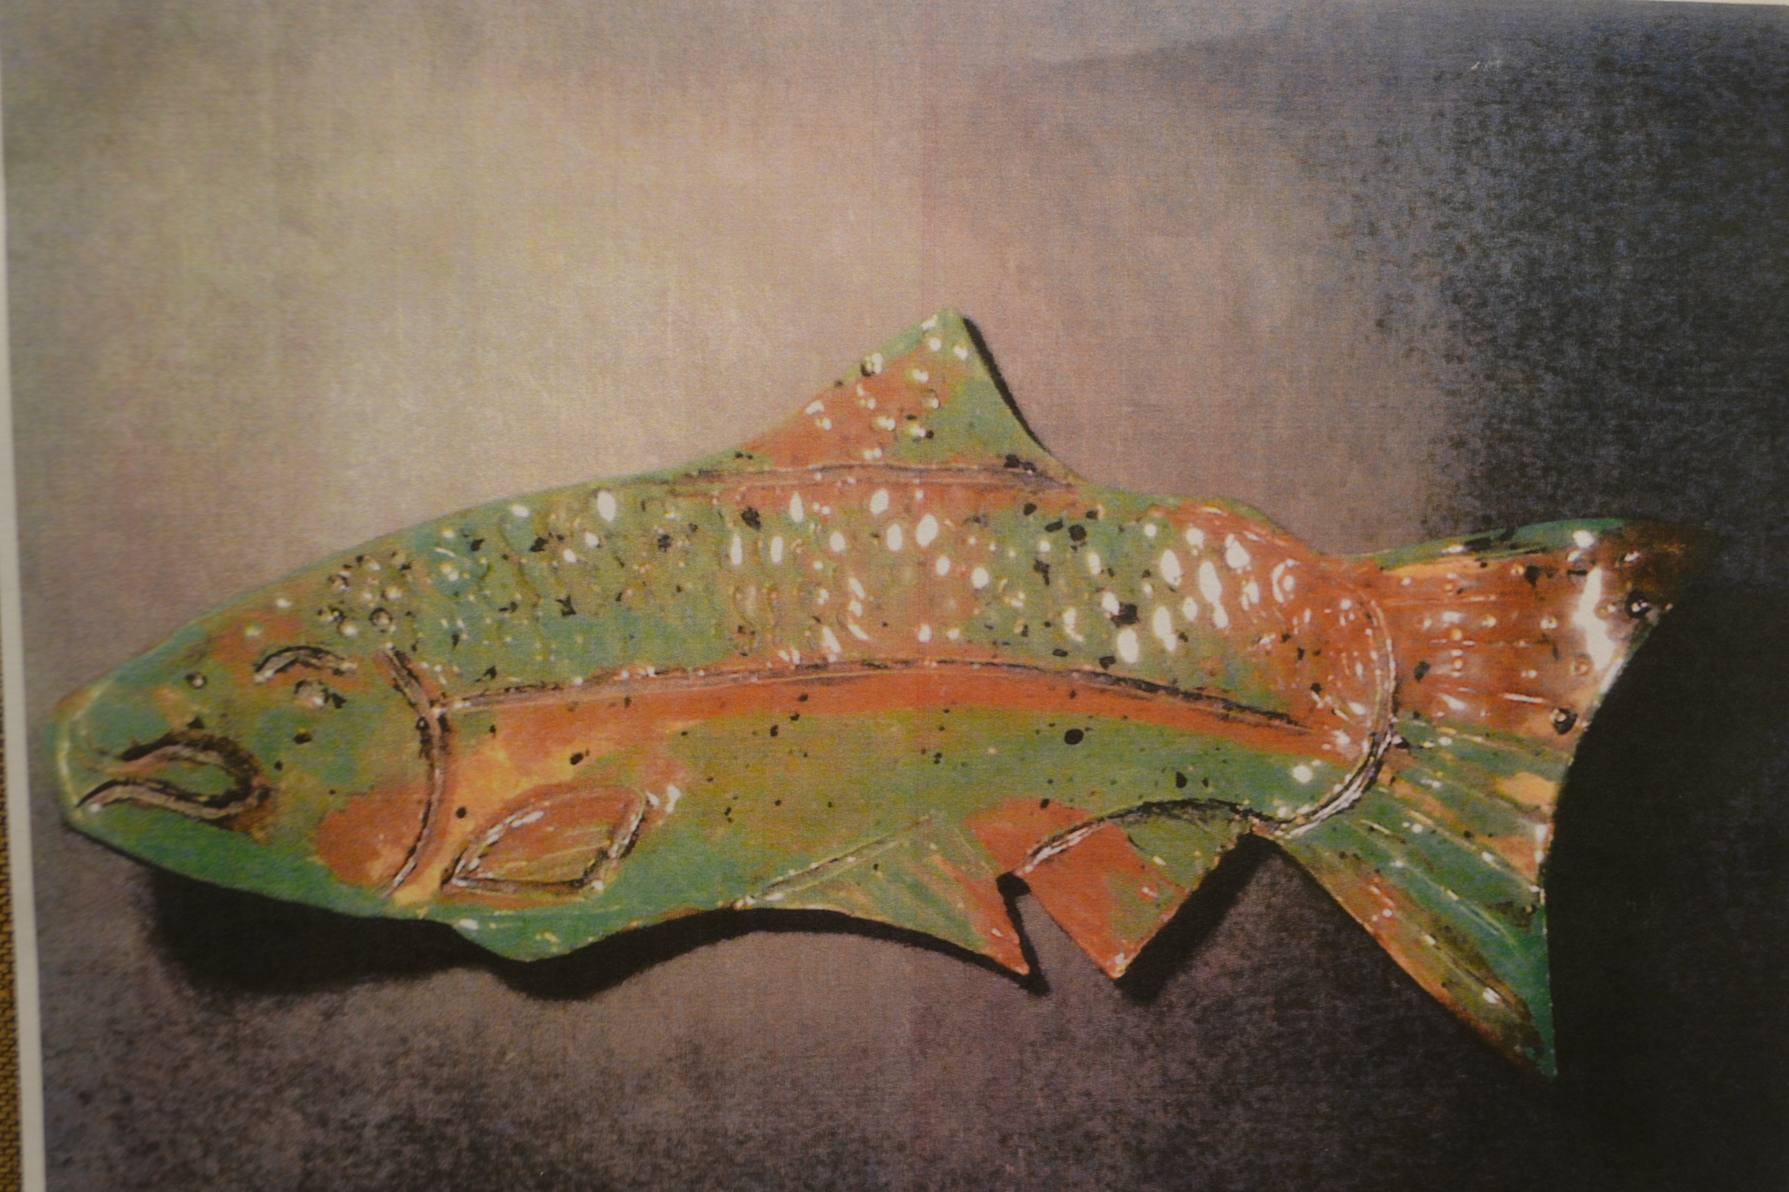
Notes:
Hi my name is _____________ and this is ____________. We are ____& ______’s moms. We are your art docents this year. (Docent usually means a specific kind of volunteer who teaches art or is a guide at a museum.) We have some other volunteers here to help you today too like_____________.
Today we will be working on part one of a clay project . Since you have been studying Salmon in the third grade, we are going to be making clay salmon platters.

Slide 3
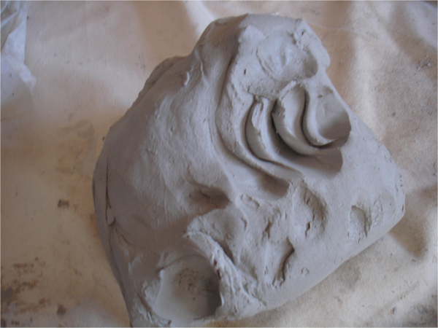

Slide 4
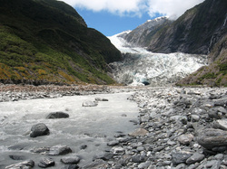
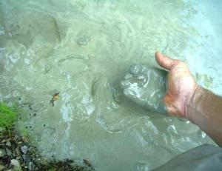
What is clay?
Minerals from the earth – specifically silica and alumina. Clay is found near rivers where small particles of rock are carried down to a lower part and collect together to form clay.
Clay characteristics –
Plastic when it’s wet –clay can be pushed, stretched, stamped, or impressed
Shrinks as it dries
Hardens as it dries – when wet it has no structural strength. Bone dry clay, before heated, is quite brittle
Clay vitrifies when subjected to sufficient heat – clay becomes hard, durable, waterproof
Notes:
What is clay?
Minerals from the earth – specifically silica and alumina. Often clay is found near rivers where small particles of rock are carried down to a lower part and collect together to form clay.
Clay characteristics –
Clay is plastic when it’s wet –clay can be pushed, stretched, stamped, or impressed
Clay shrinks as it dries
Clay hardens as it dries – when wet it has no structural strength (can slump or distort if handled roughly) Bone dry clay, before heated, is quite brittle
Clay vitrifies when subjected to sufficient heat – clay becomes hard, durable, waterproof

Slide 5
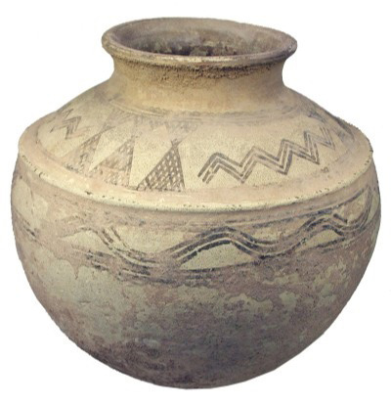
Clay pots have been around since 5000B.C.
6000 years ago!
Notes:
How long have clay projects been around?
Clay pots have been found in current day Iran and China that date back to 5000 B.C. – that’s more than 6000 years ago! People used clay to make containers for food and to make bricks to build houses ( baked clay mixed with straw called adobe). Back then they used fire to cook and harden the clay.

Slide 6
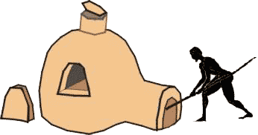
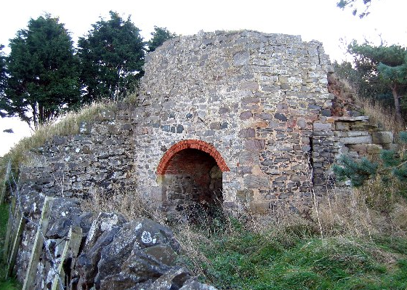
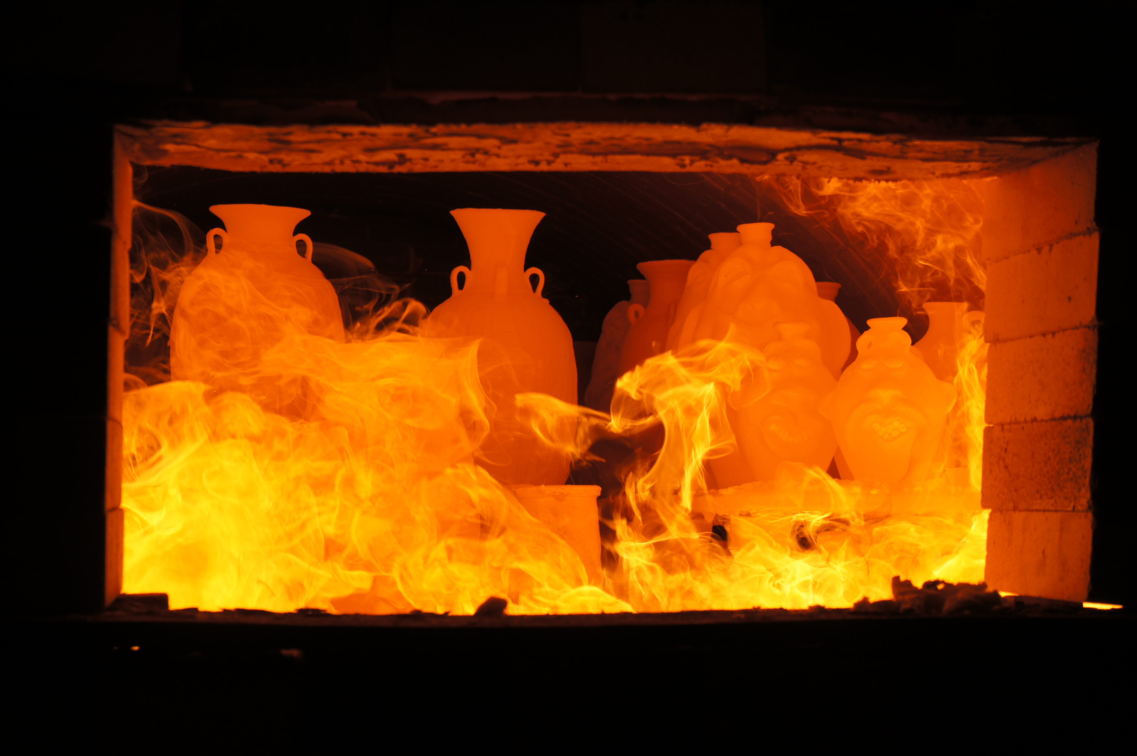
Baking with Fire!

Slide 7
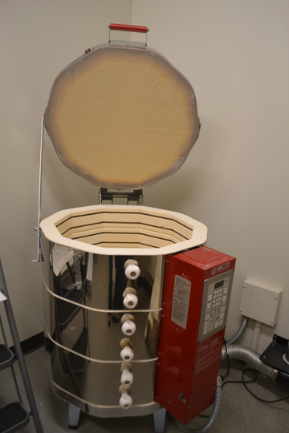
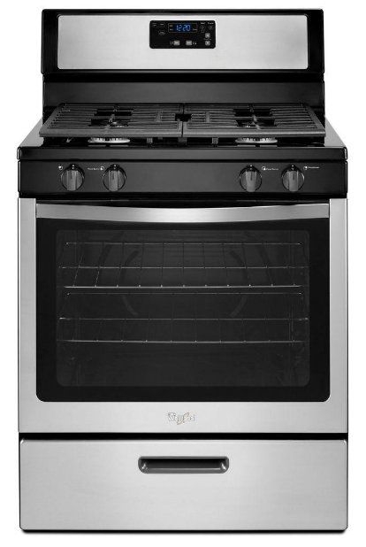
Electric Kiln
This kiln cooks at 2000 Degrees F !!!
This oven reaches 500 Degrees F
Now that is HOT!
Notes:
Today we use a special electric oven called a kiln to cook the clay. How hot does your kitchen oven at home reach when you are cooking food? 375 or 400 degrees F? Our kiln will cook your projects at about 1800 -2000 degrees F. (show photo of kiln)
Cooking in a kiln is called firing. This is important because it makes the clay stronger and more waterproof. Clay that has been kiln fired would not return to a soft state even if it were in water for a long time. That is because the extreme heat causes permanent physical and chemical changes to occur. These reactions, among other changes, cause the clay to be converted into a ceramic material.

Slide 8
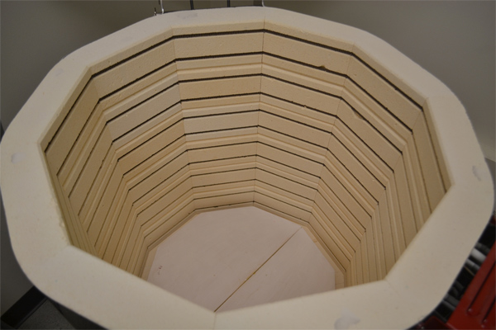
Notes:
These projects we make today will need to dry in the open air for a week or two (this is the greenware state-•Greenware (noun) is the term given to clay objects when they have been shaped but have not not yet been bisque fired, which converts them from clay to ceramic. Greenware may be in any of the stages of drying: wet, damp, soft leather-hard, leather-hard, stiff leather-hard, dry, and bone dry.)
When they are completely dry they will be fired in the kiln for the first time (bisque fired) and look like this when they are done (hold up a sample of bisque fired piece).
After that, I will come back and you will paint the projects with something called glaze which is a special liquid like a paint that’s made of bits of ground up glass. The piece will then be fired again in the kiln and will turn out like this (show a real glaze fired piece).
Getting started:
Students receive one canvas cloth on the desk, one slab of clay, dull pencil for writing name, cutting knife, texturizing tools (tongue depressors, screws, pinecones, marker caps, etc.), tagboard template of project, tray for project drying, bowl with few drops of water for fingertip smoothing)

Slide 9
Our Project Today
After we are finished with the project today, it will need to dry in the open air for a week or two
This is the greenware state-• Greenware (noun) is the term given to clay objects when they have been shaped but have not fired
Greenware may be in any of the stages of drying: wet, damp, soft leather-hard, leather-hard, stiff leather-hard, dry, and bone dry.
When they are completely dry they will be fired in the kiln for the first time (bisque fired)
bisque fired converts them from clay to ceramic
After that, I will come back and you will paint the projects with something called glaze which is a special liquid like a paint that’s made of bits of ground up glass. The piece will then be fired again in the kiln and will turn out like this (show a real glaze fired piece).

Slide 10
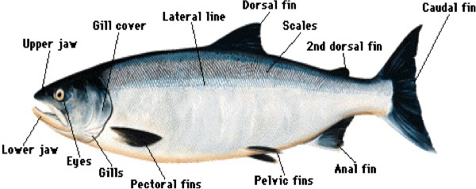
Anatomy of the salmon

Slide 11
Steps for students to make a clay salmon platter:
1. Place the template on the clay slab and trace using the knife in an upright manner all the way around the fish.
2. Remove template and lift clay fish up to scratch name on back with dull pencil
3. Place clay fish aside.
4. Use scrap pieces of clay to practice with texturizing tools to see what effects will help you achieve the look of scales, fins, etc. (try the tip of the popsicle stick)
5. Take the clay salmon and draw the dividing lines on the salmon to separate the different parts of the body (Don’t cut too deep!)
Use the texturizing tools to add details like scales, ridges in the fins, eye, etc.
Use a scoring technique to attach separate pieces such as an eye.
Use a finger with one drop of water (not too much) to smooth all the edges so they won’t be jagged or sharp once fired.
Clean up – dunk hands in bucket of water first to get big chunks of clay off so they don’t go down the drain and clog it. Then wash with soap and water in sink.

Slide 12
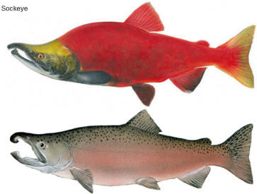
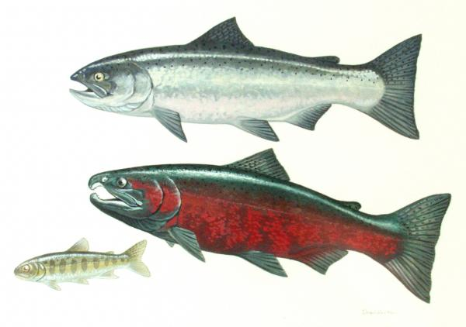
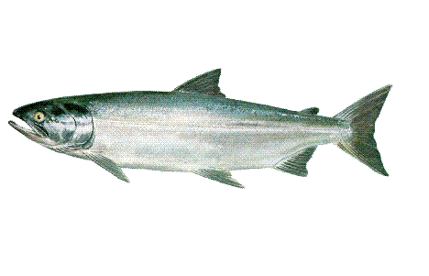
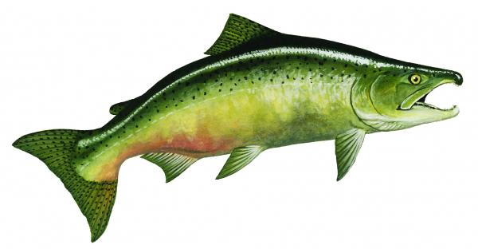
jfijfkdj
Notes:
This slide can be printed and used when glazing to give the students ideas for where to place color.

Slide 13
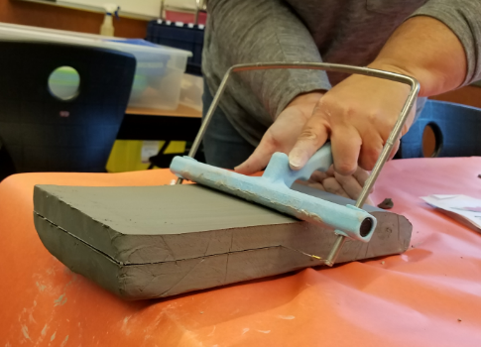
Notes to the Docent
Rolling and Slicing Clay:
Slice Clay slab 7/8” thick from the block of clay lengthwise
Set the clay roller to just shy of 3/8” thick
Roll clay between cloth horizontal
Can get 8 slabs per block

Slide 14
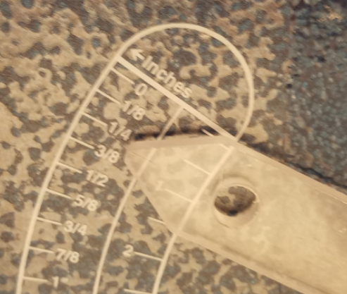
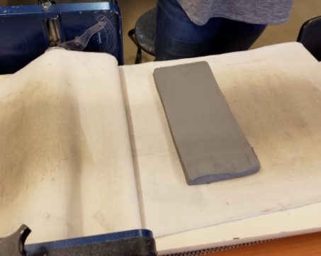
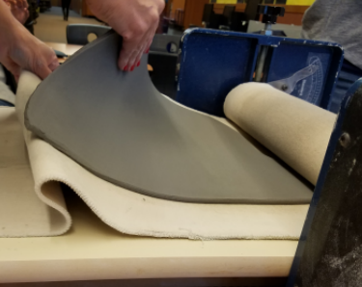
Rolling the Clay

Slide 15
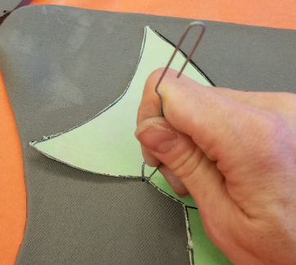
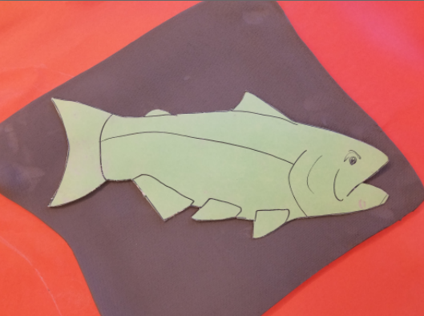
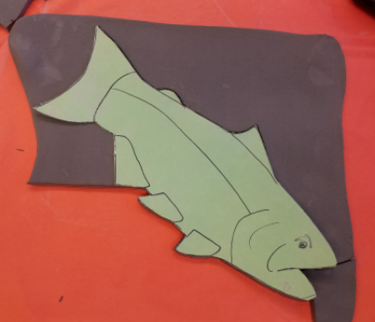
Making the Salmon
Step 1
Step 2
Place the fish cut out template on the rolled sheet of clay so that it fits.
Start tracing the template with a thin object like a large paperclip.

Slide 16
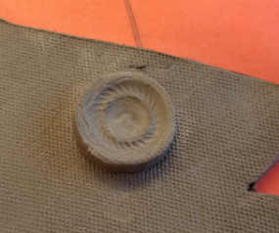
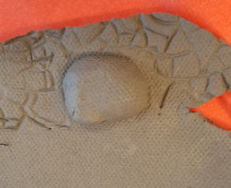
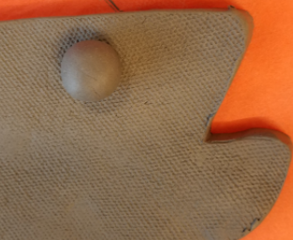
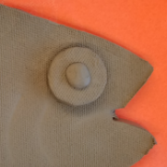
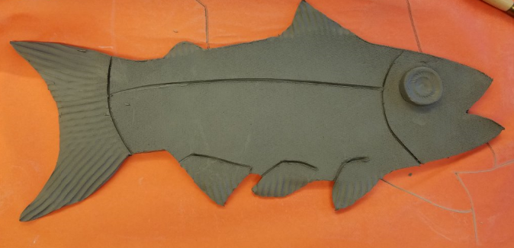
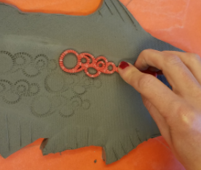
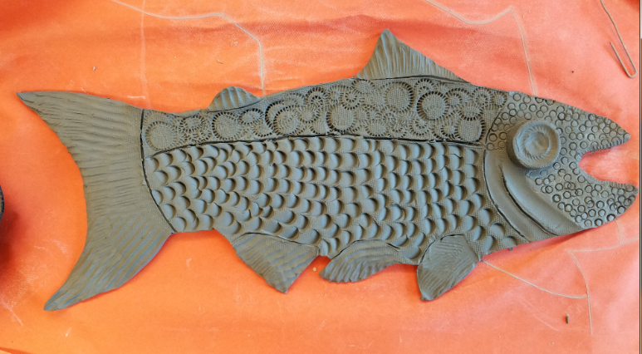
3
Next Couple Steps:
4
Step 3 – pull away the excess cut pieces
Step 4 – Make an eye from the excess clay.
Step 5 - Define the fins and body parts
Step 6 - Add textures and designs
5
6
Remember: don’t cut or press too hard when adding texture, or else it will cut through the fish. Then the plate will have a hole or weak part where you went too deep.

Slide 17
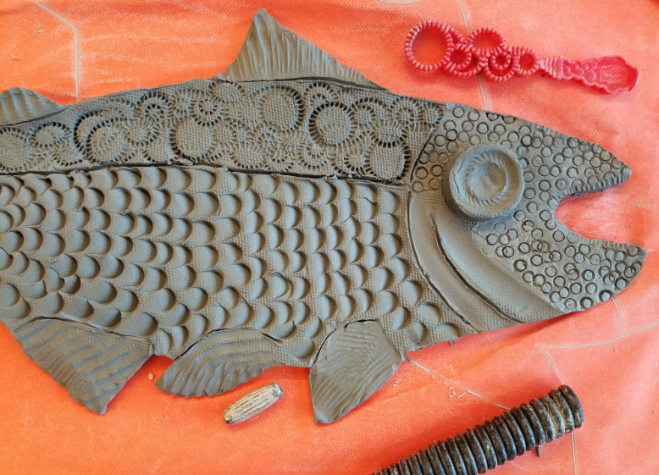
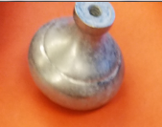
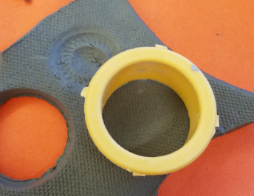
This Example used Tool:
This fish was made using:
Circle cookie cutter & Door knob for eye pattern
Popsicle stick for scales
Bubble wand for upper scales
Tube shaped bead
End of bead to make face
Side of bead to make fins
Telephone coil for larger fins
Paper clip to define body parts and fins

Slide 18
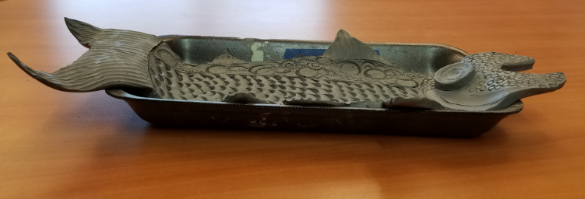
Place your Fish
Carefully pick up your fish and put it into a long dish to achieve the curved up sides
Shape the pieces that hang over the side into the desired shape you want when it is dry

